Slide 1


R.M.D. Engineering College
22CS202
JAVA PROGRAMMING
UNIT V

Slide 2
DATABASE
A database is a structured collection of data that is organized, managed, and stored in a way that enables efficient retrieval, manipulation, and analysis of information. It is designed to store large amounts of data, ranging from simple text or numerical values to complex multimedia files.
In a database, data is organized into tables, which consist of rows and columns. Each row represents a record or a specific instance of data, while each column represents a specific attribute or data field. This tabular structure allows for easy organization and retrieval of data based on various criteria.
Databases provide a structured and standardized way to store and manage data, ensuring data integrity, consistency, and security. They offer functionalities such as data validation, data indexing, and data relationships, which help maintain the accuracy and reliability of the stored information.

Slide 3
TYPES OF DATABASE
Relational Databases: Relational databases store data in structured tables with predefined schemas. They use the SQL (Structured Query Language) for defining and manipulating the data. Examples of relational databases include MySQL, Oracle Database, Microsoft SQL Server, and PostgreSQL.
NoSQL Databases: NoSQL (Not Only SQL) databases are designed to handle unstructured or semi-structured data. They provide flexible schemas and can handle large amounts of data and high scalability. NoSQL databases are categorized into several subtypes, including:
Columnar Databases: Store data in columnar format, which allows efficient querying and analysis of specific columns. Examples include Apache Cassandra and HBase.
Object-Oriented Databases: Object-oriented databases store data in objects, which are instances of classes. They allow direct storage and retrieval of complex data structures, including objects with behavior and relationships. Examples include db4o and ObjectDB.
Hierarchical Databases: Hierarchical databases organize data in a tree-like structure, where each record has a parent-child relationship. They are suitable for storing data with a fixed and predefined structure. Examples include IBM's Information Management System (IMS) and Windows Registry.
Network Databases: Network databases also organize data with a network-like structure but allow records to have multiple parent and child relationships. They are designed for complex and interconnected data. Examples include Integrated Data Store (IDS) and Integrated Database Management System (IDMS).
Time-Series Databases: Time-series databases specialize in storing and analyzing time-stamped data, such as sensor readings, financial market data, or server logs. They are optimized for efficient storage and retrieval of time-series data. Examples include InfluxDB and Prometheus.

Slide 4
SQL QUERIES
(Structured Query Language) is a standard language for interacting with relational databases. It provides a set of commands and statements that allow you to perform various operations on the data stored in a database. Here are some commonly used queries:
SELECT: The SELECT statement is used to retrieve data from one or more tables in the database.
SELECT column1, column2 FROM table_name;
Example:
SELECT name, age FROM employees;
INSERT: The INSERT statement is used to insert new rows of data into a table.
INSERT INTO table_name (column1, column2) VALUES (value1, value2);
Example:
INSERT INTO employees (name, age) VALUES ('John Doe', 30);
UPDATE: The UPDATE statement is used to modify existing data in a table.
UPDATE table_name SET column1 = value1, column2 = value2 WHERE condition;

Slide 5
DELETE: The DELETE statement is used to remove rows from a table.
DELETE FROM table_name WHERE condition;
Example:
DELETE FROM employees WHERE id = 1;
JOIN: The JOIN statement is used to combine rows from two or more tables based on a related column between them.
SELECT column1, column2 FROM table1 JOIN table2 ON table1.column = table2.column;
Example:
SELECT employees.name, departments.department_name FROM employees JOIN departments ON employees.department_id = departments.department_id;
WHERE: The WHERE clause is used to filter rows based on a specified condition.
SELECT column1, column2 FROM table_name WHERE condition;
Example:
SELECT name, age FROM employees WHERE age > 30;
GROUP BY: The GROUP BY clause is used to group rows based on a specified column and perform aggregate functions on grouped data.
SELECT column1, COUNT(column2) FROM table_name GROUP BY column1;
Example:
SELECT department_id, COUNT(*) FROM employees GROUP BY department_id;
ORDER BY: The ORDER BY clause is used to sort the result set based on one or more columns

Slide 6
JDBC data source
JDBC Data Sources provide a way to manage and pool database connections in Java applications. Instead of manually managing individual connections, a data source abstracts the connection management and provides a standardized way to access connections from a connection pool.
Using a data source offers several benefits, including improved performance, scalability, and efficient connection management. It allows applications to reuse and share database connections, reducing the overhead of establishing new connections for each request.
To use a data source in Java, you typically follow these steps:
Configure the data source: The configuration depends on the specific data source implementation you are using. Common configurations include the database URL, username, password, and connection pool settings such as the maximum number of connections.
Create and initialize the data source object: Instantiate the data source object and set its properties based on the configuration.
Acquire connections: Use the data source to obtain connections from the connection pool.
Use the connection for database operations: Perform your database operations using the acquired connection.
Release the connection: Return the connection back to the connection pool after you are done with it. This allows the connection to be reused by other parts of the application

Slide 7

Introduction to JDBC

Slide 8
JDBC - Java Database Connectivity.
JDBC provides API or Protocol to interact with different databases.
With the help of JDBC driver we can connect with different types of databases.
Driver is must needed for connection establishment with any database.
A driver works as an interface between the client and a database server.

Slide 9
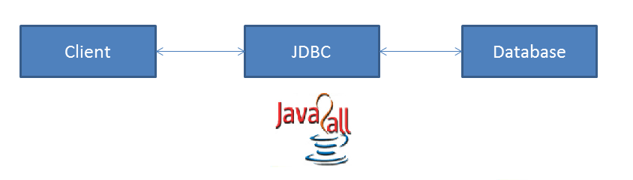
JDBC have so many classes and interfaces that allow a java application to send request made by user to any specific DBMS(Data Base Management System).
JDBC supports a wide level of portability.
JDBC provides interfaces that are compatible with java application

Slide 10
components and specification of JDBC:

Slide 11
Components of JDBC:
JDBC has four main components as under and with the help of these components java application can connect with database.
The JDBC API - it provides various methods and interfaces for easy communication with database.
The JDBC DriverManager - it loads database specific drivers in an application to establish connection with database.
The JDBC test suite - it will be used to test an operation being performed by JDBC drivers.
The JDBC-ODBC bridge - it connects database drivers to the database.

Slide 12
JDBC Specification:
Different version of JDBC has different specification as under.
JDBC 1.0 - it provides basic functionality of JDBC.
JDBC 2.0 - it provides JDBC API(JDBC 2.0 Core API and JDBC 2.0 Optional Package API).
JDBC 3.0 - it provides classes and interfaces in two packages(java.sql and javax.sql).
JDBC 4.0 - it provides so many extra features like Auto loading of the driver interface.
Connection management.
ROWID data type support.

Slide 13
Enhanced support for large object like BLOB(Binary Large Object) and CLOB(Character Large Object).

Slide 14
JDBC Architecture:
As we all know now that driver is required to communicate with database.
JDBC API provides classes and interfaces to handle request made by user and response made by database.
Some of the important JDBC API are as under.
DriverManager Driver
Connection Statement
PreparedStatement CallableStatement
ResultSet DatabaseMetaData
ResultSetMetaData

Slide 15
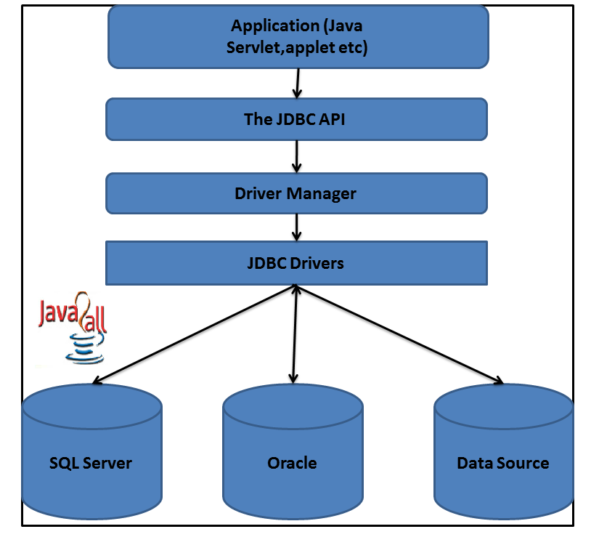
Here The DriverManager plays an important role in JDBC architecture.
It uses some database specific drivers to communicate our J2EE application to database.

Slide 16
As per the diagram first of all we have to program our application with JDBC API.
With the help of DriverManager class than we connect to a specific database with the help of spcific database driver.
Java drivers require some library to communicate with the database.
We have four different types of java drivers.
We will learn all that four drivers with architecture in next chapter.

Slide 17
Some drivers are pure java drivers and some are partial.
So with this kind of JDBC architecture we can communicate with specific database.
We will learn programmatically all this thing in further chapter.

Slide 18
JDBC CONFIGURATION
Java configuration properties are added to the agent automatically.
If JDBC data source defined in the agent, then common configuration fields are added to the agent automatically
1. JDBC database type:
Type of database to which you are connecting, IBM® DB2®, Microsoft SQL Server, or Oracle Database Server
2. JDBC user name:
User name that is used to authenticate with the database server
3. JDBC password:
Password that is used to authenticate with the database server

Slide 19
JDBC CONFIGURATION
4. Base paths:
List of directories that are searched for JAR files that are named in the
Class Path field
JAR directories field that are not fully qualified.
Directory names are separated by
a semicolon(;) on Windows,
a semi-colon(;) or colon(:) on UNIX systems
5. Class path:
Explicitly named JAR files to be searched by the agent
Any files that are not fully qualified are appended to each of the Base Paths until the JAR file is found

Slide 20
JDBC CONFIGURATION
JAR directories:
List of directories that are searched for JAR files
Directory names are separated by a
semi-colon(;) on Windows
semi-colon (;) or colon (:) on UNIX systems
JAR files in these directories do not have to be explicitly identified; they are found because they are in one of these directories
Subdirectories of these directories are not searched. Any directories that are not fully qualified are appended to each of the Base Paths until the directory is found

Slide 21
JDBC CONNECTION POOLS
Connection pooling is a process of maintaining a cache of database connections
In JDBC connection pool, a pool of Connection objects are created at the time the application server starts
These objects are then managed by a pool manager that disperses connections as they are requested by clients and returns them to the pool when it determines the client is finished with the Connection object
When the connection pool server starts, it creates a predetermined number of Connection objects

Slide 22
JDBC CONNECTION POOLS
A client application performs a lookup to retrieve a reference to a DataSource object that implements the ConnectionPoolDataSource interface
Then data source implementation would retrieve a physical connection to the client application
The ConnectionPoolDataSource would return a Connection object that implemented the PooledConnection interface
PooledConnection interface dictates the use of event listeners.

Slide 23
JDBC CONNECTION POOLS
Event listeners allow the connection pool manager to capture connection events
When the driver traps a close-connection event,
it intercedes and performs a pseudo-close operation that merely takes the Connection object
returns it to the pool of available connection
performs any housekeeping that is necessary

Slide 24
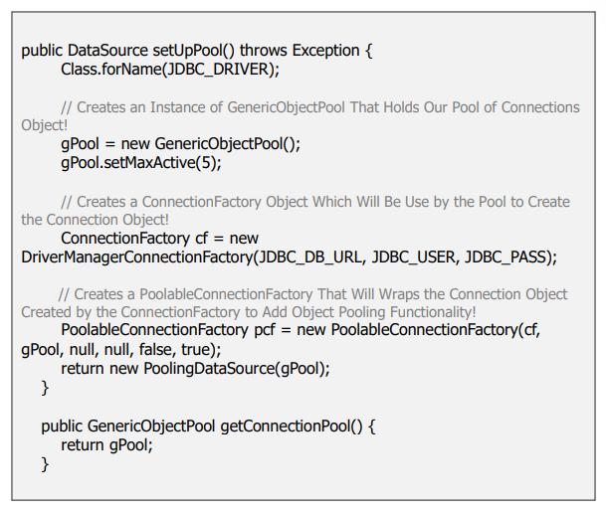

Slide 25
Driver Types

Slide 26
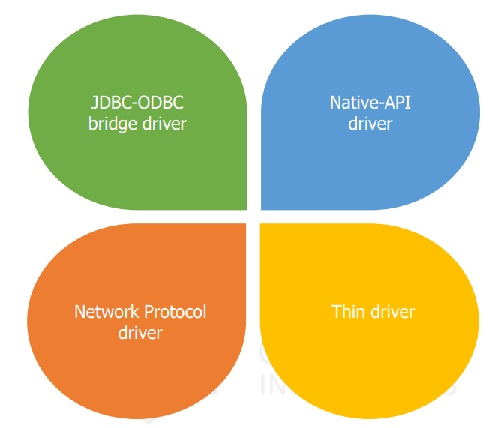
JDBC Driver Types
JDBC Driver is a software component that enables java application to interact with the database.
There are 4 types of JDBC drivers:
Type-1 driver or JDBC-ODBC bridge driver
Type-2 driver or Native-API driver
Type-3 driver or Network Protocol driver
Type-4 driver or Thin driver

Slide 27
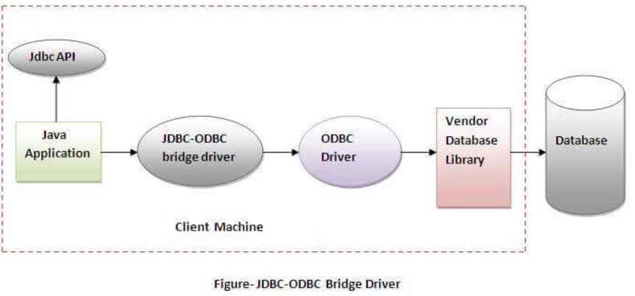
JDBC-ODBC bridge driver(Type-1 Driver)
The JDBC-ODBC bridge driver uses ODBC driver to connect to the database.
The JDBC-ODBC bridge driver converts JDBC method calls into the ODBC function calls.
JDBC-ODBC bridge driver is also called Universal driver because it can be used to connect to any of the databases.
In Java 8, the JDBC-ODBC Bridge has been removed.

Slide 28
JDBC-ODBC bridge driver (Type-1 Driver)
Advantages:
Easy to use.
Can be easily connected to any database.
Disadvantages:
Performance degraded because JDBC method call is converted into the ODBC function calls.
The ODBC driver needs to be installed on the client machine.

Slide 29
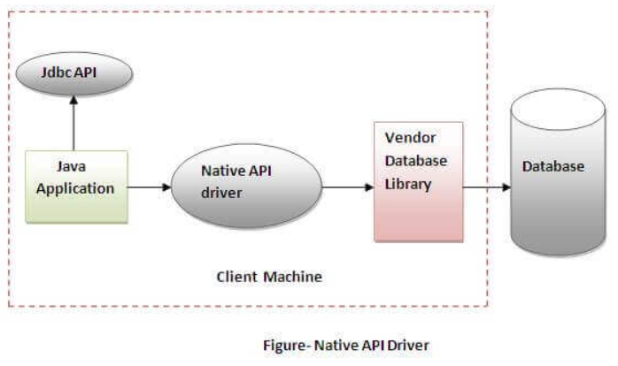
Native API Driver (Type-2 Driver)
The Native API driver uses the client-side libraries of the database.
The driver converts JDBC method calls into native calls of the database API.
It is not written entirely in java, hence they are not portable drivers.

Slide 30
Native API Driver (Type-2 Driver)
Advantages:
Performance upgraded than JDBC-ODBC bridge driver
Disadvantages:
The Native driver needs to be installed on the each client machine.
The Vendor client library needs to be installed on client machine.

Slide 31
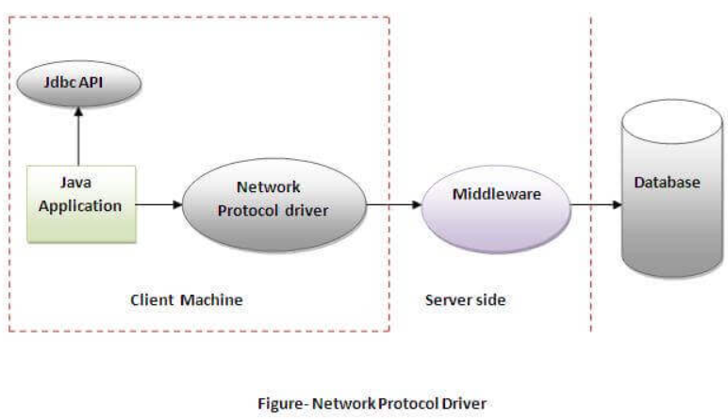
Network Protocol driver(Type-3 Driver)
The Network Protocol driver uses middleware (application server) that converts JDBC calls directly or indirectly into the vendor-specific database protocol.
It is fully written in java, hence they are portable drivers

Slide 32
Network Protocol driver(Type-3 Driver)
Advantages:
No client side library is required because of application server that can
perform many tasks like auditing, load balancing, logging etc
Disadvantages:
Network support is required on client machine.
Requires database-specific coding to be done in the middle tier.
Maintenance of Network Protocol driver becomes costly because it requires database-specific coding to be done in the middle tier

Slide 33
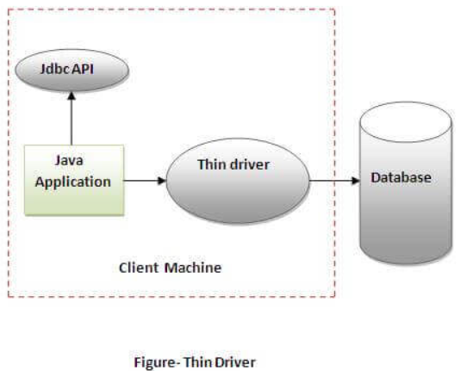
Thin Driver(Type-4 Driver)
The thin driver converts JDBC calls directly into the vendor-specific database protocol. That is why it is known as thin driver.
It is fully written in Java language, hence they are portable drivers.

Slide 34
Thin driver(Type-4 Driver)
Advantages:
Better performance than all other drivers.
No software is required at client side or server side.
Disadvantages:
Drivers depend on the Database.

Slide 35
Which driver to be used?
Thin Driver(Type-4 drivers) are preferred, If you are accessing one type of database, such as Oracle, Sybase, or IBM.
Network Protocol Driver(Type-3 drivers) are preferred, If your Java application is accessing multiple types of databases at the same time
Native API Driver(Type-2 drivers) are useful in situations, where a type 3 or type 4 driver is not available yet for your database.
The JDBC-ODBC Bridge Driver (Type-1 drivers) are not considered a deployment-level driver, and typically used for development and testing purposes only.

Slide 36
JDBC RESULTSETS

Slide 37
Resultsets
The SQL statements that read data from a database query, return the data in a result set.
The SELECT statement is the standard way to select rows from a database and view them in a result set.
The java.sql.ResultSet interface represents the result set of a database query. A ResultSet object maintains a cursor that points to the current row in the resultset.
The term "result set" refers to the row and column data contained in a ResultSet object

Slide 38
Methods of ResultSet Interface
Navigational methods − Used to move the cursor around.
Get methods − Used to view the data in the columns of the current row being pointed by the cursor.
Update methods − Used to update the data in the columns of the current row. The updates can then be updated in the underlying database as well.
The cursor is movable based on the properties of the ResultSet.

Slide 39
Connection methods provided by JDBC
JDBC provides the following connection methods to create statements with desired ResultSet
createStatement(int RSType, int RSConcurrency);
RSType- Type of ResultSet Object
RSConcurrency- Specify whether a result set is read-only or updatable
prepareStatement(String SQL, int RSType, int RSConcurrency);
A String object that contains the SQL statement to be sent to the database
RSType- Type of ResultSet Object
RSConcurrency- Specify whether a result set is read-only or updatable
prepareCall(String sql, int RSType, int RSConcurrency);
A String object that contains the SQL statement to be sent to the database
RSType- Type of ResultSet Object
RSConcurrency- Specify whether a result set is read-only or updatable

Slide 40
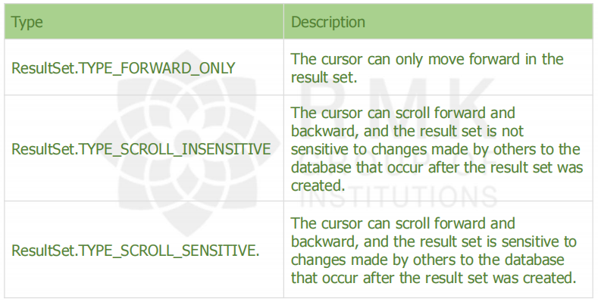
Type of ResultSet
The possible Resultset types are given below.
If any ResultSet Type is not specified, by default it will be TYPE_FORWARD_ONLY.

Slide 41
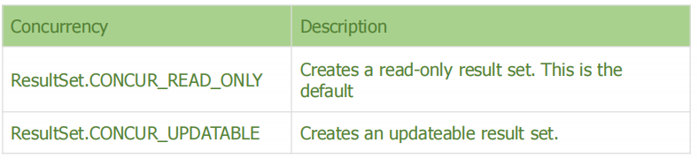
Concurrency of ResultSet
The possible Resultset concurrency are given below.
If any Concurrency Type is not specified, by default it will be CONCUR_READ_ONLY.

Slide 42
Navigating a Result Set -Methods & Description
public void beforeFirst() throws SQLExceptionMoves the cursor just before the first row.
public void afterLast() throws SQLExceptionMoves the cursor just after the last row.
public boolean first() throws SQLExceptionMoves the cursor to the first row.
public void last() throws SQLExceptionMoves the cursor to the last row.
public boolean absolute(int row) throws SQLExceptionMoves the cursor to the specified row.
public boolean relative(int row) throws SQLExceptionMoves the cursor the given number of rows forward or backward, from where it is currently pointing.
public boolean previous() throws SQLExceptionMoves the cursor to the previous row. This method returns false if the previous row is off the result set.
public boolean next() throws SQLExceptionMoves the cursor to the next row. This method returns false if there are no more rows in the result set.
public int getRow() throws SQLExceptionReturns the row number that the cursor is pointing to.
public void moveToInsertRow() throws SQLExceptionMoves the cursor to a special row in the result set that can be used to insert a new row into the database. The current cursor location is remembered.
public void moveToCurrentRow() throws SQLExceptionMoves the cursor back to the current row if the cursor is currently at the insert row; otherwise, this method does nothing

Slide 43
Updating a Result Set -Methods & Description
public void updateString(int columnIndex, String s) throws SQLException Changes the String in the specified column to the value of s.
public void updateString(String columnName, String s) throws SQLException Similar to the previous method, except that the column is specified by its name instead of its index.
public void updateRow()Updates the current row by updating the corresponding row in the database.
public void deleteRow()Deletes the current row from the database
public void refreshRow()Refreshes the data in the result set to reflect any recent changes in the database.
public void cancelRowUpdates()Cancels any updates made on the current row.
public void insertRow()Inserts a row into the database. This method can only be invoked when the cursor is pointing to the insert row.

Slide 44
Viewing a ResultSet
Method | Description
public int getInt(int columnIndex) throws SQLException | Returns the data in the current row of the specified column index as int
public String getString(int columnIndex)throws SQLException | Returns the data in the current row of the specified column index as String
public float getFloat(int columnIndex)throws SQLException | Returns the data in the current row of the specified column index as float
public int getInt(String columnName) throws SQLException | Returns the data in the current row of the specified columnname in the argument as int
public String getString(String columnName)throws SQLException | Returns the data in the current row of the specified columnname in the argument as String
public String getFloat(String columnName)throws SQLException | Returns the data in the current row of the specified columnname in the argument as float

Slide 45
Example:
import java.sql.*;
class FetchRecord
{
public static void main(String args[])throws Exception
{
Class.forName("oracle.jdbc.driver.OracleDriver");
Connection con=DriverManager.getConnection("jdbc:oracle:thin:@localhost:1521:xe","system","oracle");
Statement stmt=con.createStatement();
ResultSet rs=stmt.executeQuery("select * from employee");
//Fetching the record of 2nd row
rs.absolute(2);
System.out.println(rs.getString(1)+" "+rs.getString(2)+" "+rs.getString(3));
con.close();
}
}
Consider the employee table
Program Output:
12 Bob 55000
empid | name | salary
11 | Alex | 44000
12 | Bob | 55000
13 | John | 66000

Slide 46
import java.sql.*;
class FetchRecord
{
public static void main(String args[])throws Exception
{
Class.forName("oracle.jdbc.driver.OracleDriver");
Connection con=DriverManager.getConnection("jdbc:oracle:thin:@localhost:1521:xe","system"
,"oracle");
Statement stmt=con.createStatement(ResultSet.TYPE_SCROLL_SENSITIVE,ResultSet.CONCU R_UPDATABLE);
ResultSet rs=stmt.executeQuery("select * from emp765");
//getting the record of 3rd row rs.absolute(3);
System.out.println(rs.getString(1)+" "+rs.getString(2)+" "+rs.getString(3)); con.close();
}}

Slide 47


PreparedStatement Interface
The PreparedStatement interface is a subinterface of Statement. It is used to execute parameterized query.
“?” is passed as the parameter, the value will be set by calling the setter methods of PreparedStatement.
The prepareStatement() method of Connection interface is used to return the object of PreparedStatement.

Slide 48
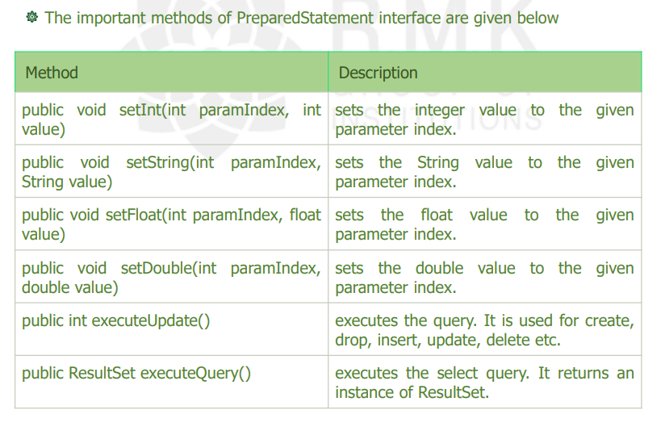
PreparedStatement -Methods

Slide 49
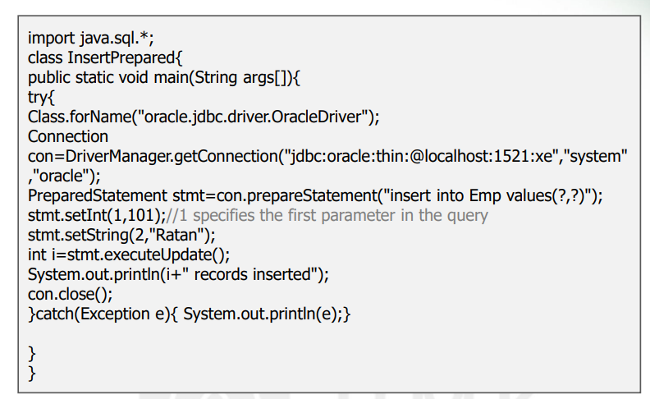
Inserting a Record

Slide 50
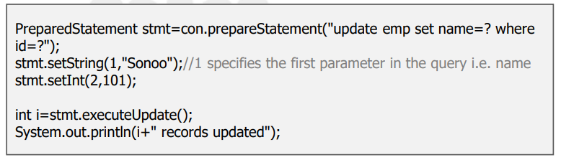
Updating the record

Slide 51
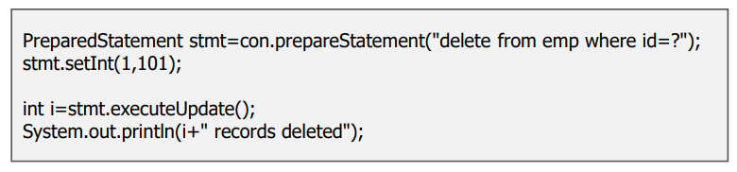
Delete the record

Slide 52
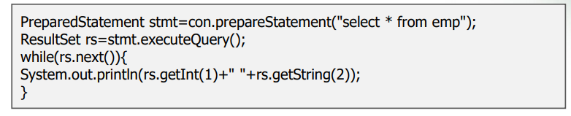
Retrieving the records of a table

Slide 53
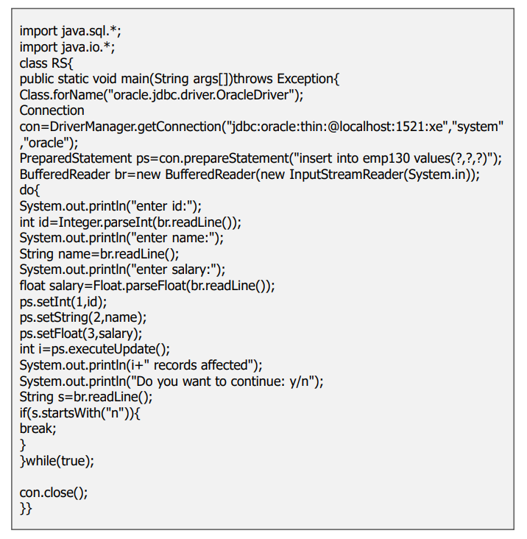
Inserting records until user press n

Slide 54
Named Parameters
In PreparedStatement parameters are anonymous and accessed by index for small queries with one or two parameters, this is not an issue. for larger queries, keeping track of the indices becomes very difficult.
NamedParameterStatement helps in overcoming this drawback. Named parameters are parameters in a query that are prefixed with a colon (:).
Named parameters in a query are bound to an argument by the javax.persistence.Query.setParameter(String name, Object value) method.
The syntax is the same as PreparedStatement except that, instead of question marks, parameters are represented as a colon followed by an identifier.

Slide 55
String query = "select * from people where (first_name = :name or last_name
= :name) and address = :address");
NamedParameterStatement p = new NamedParameterStatement(con, query); p.setString("name", name);
p.setString("address", address);

Slide 56
Behind the scenes, the class works by replacing the parameter markers with questions marks and creating a PreparedStatement.
A mapping is kept between parameter names and their indices. This mapping is referred to when the parameters are injected.
Connection con=getConnection();
String query="select * from my_table where name=:name or address=:address";
NamedParameterStatement p=new NamedParameterStatement(con, query); p.setString("name", "bob");
p.setString("address", "123 terrace ct"); ResultSet rs=p.executeQuery();

Slide 57
Named parameters are very handy when we start having methods with a lot of parameters and we want to allow invoking the method with an arbitrary subset of them, using default values for the rest.

Slide 58
Embedded SQL (SQLJ)
SQLJ is an emerging database programming tool that allows embedding of static SQL statements in Java programs.
The SQLJ translator converts Java programs embedded with static SQL statements into pure Java code, which can then be executed through a JDBC driver against the database. Programmers can also perform dynamic SQL access to the database using JDBC features.
1. Import necessary classes.In addition to the JDBC classes, java.sql.*, every SQLJ program will need to include the SQLJ run-time classes sqlj.runtime.* and sqlj.runtime.ref.*. In addition, to establish the default connection to Oracle, the Oracle class from the oracle.sqlj.runtime.* package is required.

Slide 59
import java.sql.*;
import sqlj.runtime.*;
import sqlj.runtime.ref.*;
import java.io.*;
import oracle.sqlj.runtime.*;

Slide 60
Register the JDBC driver, if needed. If a non-Oracle JDBC driver is being used, a call to the registerDriver method of the DriverManager class is necessary.
Connect to the database. Connecting to the Oracle database is done by first obtaining a DefaultContext object using the getConnection method. url is the database URL, and user and password are the Oracle user ID and password, respectively. Setting autoCommit to true would create the connection in autocommit mode, and setting it to false would create a connection in which the transactions must be committed by the programmer.

Slide 61
public static DefaultContext getConnection
(String url,String user,String password,boolean autoCommit) throws SQLException
DefaultContext cx1 = Oracle.getConnection("jdbc:oracle:oci8:@","book","book",true);
The DefaultContext object so obtained is then used to set the static default context.
DefaultContext.setDefaultContext(cx1);

Slide 62
This DefaultContext object now provides the default connection to the database.
4. Embed SQL statements in the Java program. Once the default connection has been established, SQL statements can be embedded within the Java program using the following syntax
where #sql indicates to the SQLJ translator, called sqlj, that what follows is an SQL statement and <sql-statement> is any valid SQL statement, which may include host variables and host expressions.
#sql {<sql-statement>}

Slide 63
import sqlj.runtime.*;
import sqlj.runtime.ref.*;
import java.sql.*;
import java.io.*;
import oracle.sqlj.runtime.*;
public class Simple1
{
public static void main (String args[]) throws SQLException
{ DefaultContext cx1 = Oracle.getConnection("jdbc:oracle:oci8:@", "book","book",true);
DefaultContext.setDefaultContext(cx1); String cn;
Double ap,bp,cp;
String sym = readEntry("Enter symbol : ").toUpperCase();
try {
#sql {select cname,current_price,ask_price,bid_price into :cn,:cp,:ap,:bp from security
where symbol = :sym };
}

Slide 64
catch (SQLException e)
{
System.out.println("Invalid symbol."); return;
}
System.out.println("\n Company Name = " + cn);
System.out.println(" Last sale at = " + cp);
if (ap == null)
System.out.println(" Ask price = null");
else
System.out.println(" Ask price = " + ap);
if (bp == null)
System.out.println(" Bid price = null");
else
System.out.println(" Bid price = " + bp);
}
}

Slide 65
Connection Close and Cleanup
public static void close(ResultSet rs, Statement st)
{
if (rs != null) {
try
{
rs.close();
} catch (SQLException e)
{
SilverTrace.error("util", "DBUtil.close", "util.CAN_T_CLOSE_RESULTSET",e);
}
}
if (st != null) {
try
{
st.close();
}
catch (SQLException e)
{
SilverTrace.error("util", "DBUtil.close", "util.CAN_T_CLOSE_STATEMENT",e);
}
}
}
In a Java program, we sometimes need to make sure we close a resource after we’ve finished using it.
The database-related ones are particular important – if we don’t close them, we can be left with unclosed connections to the database.

Slide 66
import java.sql.Connection;
import java.sql.ResultSet;
import java.sql.SQLException;
import java.sql.Statement;
public class Main
{
static public void cleanupJDBCResouce(ResultSet rs, Statement stmt, String oldCatalog, Connection conn)
{
try {
if (rs != null)
rs.close();
}
catch (SQLException e)
{
// TODO log properly JDBCASEPlugin.getDefault().log(e); e.printStackTrace();
}
try {
if (stmt != null)
stmt.close();
}
catch (SQLException e)
{
// TODO log properly JDBCASEPlugin.getDefault().log(e);
e.printStackTrace();
}
try
{
if (oldCatalog != null) conn.setCatalog(oldCatalog);
}
catch (SQLException e)
{
// TODO log properly JDBCASEPlugin.getDefault().log(e);
e.printStackTrace();
}
}
}

Slide 67
import java.io.*;
import java.sql.*;
class JDBCExample
{
public static void main(String[] args) throws Exception
{
String url = "jdbc:mysql://localhost:3306/table_name"; // table details String username = "root"; // MySQL credentials
String password = "";
String query = "select *from students"; // query to be run
Class.forName(
"com.mysql.cj.jdbc.Driver"); // Driver name
Connection con = DriverManager.getConnection( url, username, password);
System.out.println(
"Connection Established successfully"); Statement st = con.createStatement(); ResultSet rs
= st.executeQuery(query); // Execute query rs.next();
String name = rs.getString("name"); // Retrieve name from db
System.out.println(name); // Print result on console
st.close(); // close statement
con.close(); // close connection
System.out.println("Connection Closed....");
}
}

Slide 68
Advantages of database connection
Data Management: Java provides a robust and structured way to interact with databases, allowing you to efficiently store, retrieve, update, and delete data. SQL queries or higher-level abstractions like ORM frameworks to handle database operations.
Data Persistence: By connecting a database with Java, you can persist data beyond the lifespan of your application. This means that data remains stored even after the application is closed or the server is shut down. This ensures data integrity and allows for seamless data retrieval in subsequent sessions.
Scalability: Databases are designed to handle large volumes of data and concurrent access. By connecting a database with Java.

Slide 69
Data Security: Databases offer built-in security features to protect sensitive data. By connecting a database with Java, you can enforce access controls, implement authentication and authorization mechanisms, and encrypt data to ensure its confidentiality and integrity.
Data Management: Java provides a robust and structured way to interact with databases, allowing you to efficiently store, retrieve, update, and delete data. SQL queries or higher-level abstractions like ORM frameworks to handle database operations.
Data Persistence: By connecting a database with Java, you can persist data beyond the lifespan of your application. This means that data remains stored even after the application is closed or the server is shut down. This ensures data integrity and allows for seamless data retrieval in subsequent sessions.

Slide 70
Disadvantages of database connection
Performance Overhead: Database connections in Java can introduce performance overhead compared to direct access to data in memory. The process of establishing a connection, executing queries, and retrieving data involves additional layers of abstraction and network communication, which can impact the overall performance of the application.
Complexity: Working with databases in Java often involves writing SQL queries, handling database connections, and managing transactions. This complexity can be challenging, especially for developers who are new to database programming or lack familiarity with SQL. It may require additional effort to learn and understand the intricacies of database interactions.
Dependency on Database Vendor: Connecting a database with Java usually involves using a specific JDBC driver provided by the database vendor. This dependency on a particular vendor's driver may limit portability and make it more challenging to switch to a different database system in the future, as the driver implementation and behavior may vary.

Slide 71
Potential for SQL Injection: When constructing SQL queries dynamically by concatenating user input, there is a risk of SQL injection attacks. If not handled properly, malicious users may exploit vulnerabilities in the application to execute unauthorized SQL commands or gain access to sensitive data. Preventing SQL injection requires careful input validation and the use of parameterized queries or prepared statements.
Data Access Coupling: Directly accessing the database from Java code can lead to tight coupling between the application and the database structure. Any changes to the database schema may require corresponding modifications in the Java code, potentially increasing maintenance efforts and making the application more rigid to adapt to evolving database requirements.
Database Portability: While JDBC provides a standard API for database connectivity, some database-specific features or SQL syntax may not be fully supported across different database systems. If the application needs to be compatible with multiple database vendors, it may require additional effort to ensure that the SQL queries and database-specific features are handled consistently across different database platforms.

